Slide 1
Analytics In Telecom – An Overview

Slide 2
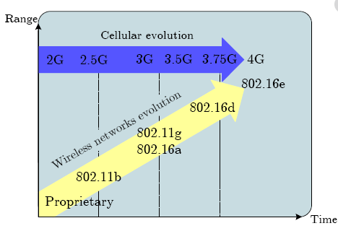
Evolution of Mobile Telecom
Technology keeps changing atleast once in 10 years
What is 5G all about??

Slide 3
What in store for Telcos?
What is in store for Telecom?
Evolve beyond 4G/LTE
Increased customer management
Monetise existing base
Capital investment on right areas
Digitization
5G
D&A shall define telecom future??
Lets also see why there is so much fuzz about 5G?
Analytics

Slide 4
What can 5G do?
All these lead to new data
More data then deeper & rich analytics
Manufacturing via Robots
Remote control of heavy machineries, robot arms in real time
All of these require ultra low latency
Connected & autonomous Vehicles
Interconnected devices at home
Reliable information exchange
Data driven decision making
Manufacturing
Industry
M2M
Smart Stadiums
360 degree AR & VR
Immersive experience
Entertainment
Health care
Health sensors(IoT)
Tele medicines
Medical support at remote place

Slide 5
4Vs of Data
Driver
Requirement
Insight
Data is the new soil
Volume
90% of world’s data generated in last 2 years
Align data initiatives to business goals
Velocity
Lets see the major data sources in Telecom Industry
Speed of data generated & the need to analyze in real time
Create scalable data handling infrastructure
Variety
Structured, unstructured and semi structured
Enhanced
capabilities on processing & visualization
Veracity

Slide 6
Sources of Data (not a exclusive list)
Data Points
Telecom Only Data
Customer related information
Network Data
Social Media Feedbacks/Comments
Marketing and Sales
Applicable to Any industry(inclusive of Telecom)
Inventory Management
Employees Related

Slide 7
Network Data at various stages
Radio Planning & Design data
Mobile Access plan
Configuration Parameters
Performance Indicators
Drive Logs
Integration Parameters
Excel & Macro Files
License Information
Feature Implementation
Audit Outcomes
Plan
Integrate
Alarm and system Log
Fault History
Event and Trouble reports
Operate
System messages
Trace logs
Case History
Crash Reports
Support

Slide 8
Telecom Analytics way forward
What
Why
Lead to
Invest on Analytics capability building
Convert business problems to analytical ones
Integrated data from various sources suitable for in depth analysis
Faster time to market with better decision making
Monetize further while improving customer experience
Robust Data Handling
Varied & large data
More powerful and real time
Nextgen Models

Slide 9
What can we do with Network Data
Create Data Lake from Network Data
Lesser time to market
Rigor on Quality
Identify opportunities
Improved Efficiency
Develop test models
Test cases to usable application
Adaptation of models to multiple projects

Slide 10
Possible Evolution Use cases
As Is state
Evolved state
Lead to
Segmented Marketing & Offers
Personalized connects
Bring real value to the customer
Reduce the response time between insight to action
Many other potential value and the opportunities are unlimited
Churn Prediction
Predict churn along with RCA & possible action
Human managed telecom network
Self Organizing & Healing Networks

Slide 11
Towards a Better Network
Sample Analytics Use cases in Network Data
Capacity Recommendation/Augmentation
Build a model based on the past network usage and suggest for the augmentation of network elements to meet the ever increasing demands
Predict Network KPIs
Model that can help to understand how the Network KPIs shall evolve based on performance indicators
Outage and Root cause analysis
Association model which can help to identify RCA based on the combination of Network Logs, PM Counters and Configuration Changes

Slide 12
Various Touch Points (not an exhaustive one)
Customer Data at various stages
Typical Customer details during sign up
Base location,Gender,Age,Occupation,Plan details etc
Usage Pattern
Type of service most used(Voice or Data)
User Behaviour( eg: most active period of the day/week etc)
Add on cards
Average Spent etc
Satisfaction Level
Feedbacks/Surveys
Number of Complaints raised

Slide 13
Towards a Better Customer Experience Management
Sample Analytics Use cases in Customer Data
Churn Reduction
Deploy model to identify possible off track customers and device engagements to win them back
Upselling Opportunities
Location Based & Other Value added Services
Promote LBS based on the customer interest & search pattern

Slide 14
Summary –Need to ACT now
Vision
Clear road ahead
Use cases
Analytics as main player
Models & Engines
Leadership alignment
Talent Pool
Integrated data
Analytical strategies
Value stream mapping
To be part of all deliverables
From Customer to Network
#Analytics as culture
Talent acquisition and retainment
Real/Near real time analysis
Action rather than just insights

Slide 15
Thanks

